Slide 1

Customer Shopping Behavior Analysis
This project analyzes customer shopping behavior using transactional data from 3,900 purchases to uncover insights into spending patterns, customer segments, product preferences, and subscription behavior. The goal is to guide strategic business decisions.

Slide 2

Project Overview and Dataset Summary
Project Goal
Uncover actionable insights from 3,900 customer purchases to optimize business strategy, focusing on spending, segmentation, and product preferences.
Dataset Scope
3,900 rows and 18 columns of transactional data, including demographics, purchase details, and shopping behavior.
Key Features
Age, Gender, Category, Purchase Amount, Subscription Status, Discount Applied, Previous Purchases, and Review Rating.
Data Note
37 missing values were identified in the Review Rating column and addressed during data preparation.

Slide 3


Exploratory Data Analysis (EDA) & Data Preparation
The initial phase involved data cleaning, standardization, and feature engineering in Python to prepare the dataset for structured analysis.
Data Preparation Steps
Data Loading & Exploration
Imported data and used df.info() and .describe() for initial structure and summary statistics.
Missing Data Handling
Imputed 37 missing values in Review Rating using the median rating of each product category.
Standardization & Cleaning
Renamed columns to snake case and dropped the redundant promo_code_used column.
Feature Engineering
Created age_group (by binning ages) and purchase_frequency_days columns.
The cleaned DataFrame was then loaded into a SQL Server Management Studio database for advanced SQL analysis.

Slide 4
Key Business Insights: Revenue and Spending
Structured SQL analysis provided clear answers to key business questions regarding revenue generation and high-spending customers.
$157,890
$75,191
58
60
Male Revenue
Female Revenue
Standard Shipping Avg. Spend
Express Shipping Avg. Spend
Total revenue generated by male customers.
Total revenue generated by female customers.
Average purchase amount for Standard shipping users.
Average purchase amount for Express shipping users.
Male customers generate significantly higher total revenue, while Express shipping users show a slightly higher average purchase amount.

Slide 5
Product Performance: Ratings and Discount Dependency
Top 5 Products by Average Review Rating
Top 5 Discount-Dependent Products
Item Purchased
Avg. Review Rating
Products with the highest percentage of purchases made with a discount applied.
Gloves
3.86
Item Purchased
Discount Rate (%)
Sandals
3.84
Hat
50
Boots
3.82
Coat
49
Hat
3.80
Sneakers
49
Skirt
3.79
Sweater
48
Pants
47
Gloves, Sandals, and Boots are the highest-rated products. Notably, the Hat is both a top-rated item and the most discount-dependent product.

Slide 6

Subscription Status and Customer Loyalty
Analyzing the impact of subscriptions and segmenting customers based on their purchase history.
Subscribers (Yes)
Total Customers: 1,053
Average Spend: $59
Total Revenue: $62,645
Non-Subscribers (No)
Total Customers: 2,847
Average Spend: $59
Total Revenue: $170,436
While non-subscribers drive the majority of revenue due to volume, the average spend is identical across both groups.
Repeat Buyers who Subscribe
Repeat Buyers
Subscribers
Repeat buyers (customers with >5 purchases) are significantly more likely to subscribe (958 subscribers vs. 2,518 non-subscribers among repeat buyers).

Slide 7



Customer Segmentation by Purchase History
Customers were classified into three segments based on their purchase history to identify loyalty levels.
New
1
83 Customers
Returning
2
701 Customers
Loyal
3
3,116 Customers
The vast majority of the customer base falls into the Loyal segment, indicating strong retention, but the small New segment suggests an opportunity for acquisition focus.

Slide 8
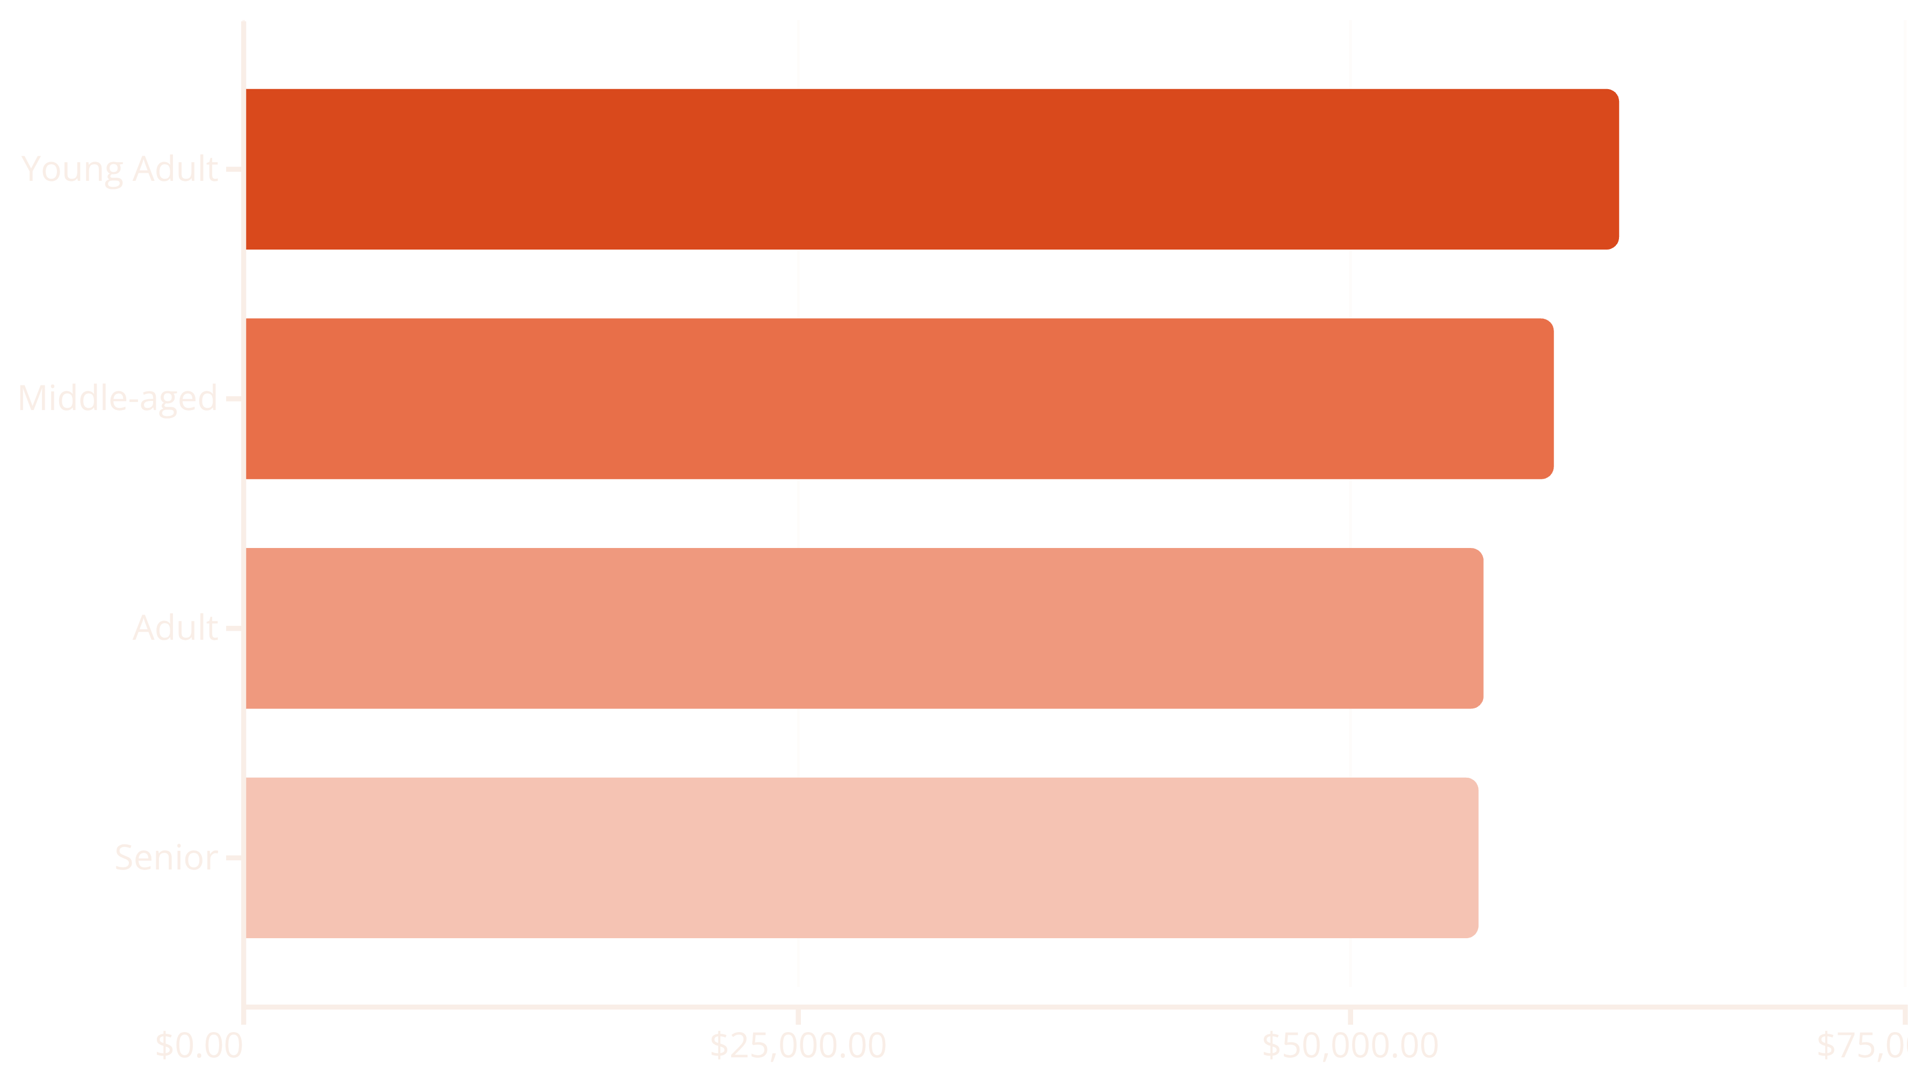
Revenue Contribution by Age Group
Understanding which age demographics contribute the most to total revenue helps in targeted marketing efforts.
The Young Adult segment (binned ages) is the largest revenue driver, followed closely by the Middle-aged group. Marketing campaigns should prioritize these high-value demographics.

Slide 9

Top Products Within Each Category
Identifying the best-selling items across the four main product categories.
Accessories
Jewelry (171 purchases)
Belt (161 purchases)
Sunglasses (161 purchases)
Clothing
Blouse (171 purchases)
Pants (171 purchases)
Shirt (169 purchases)
Footwear
Sandals (160 purchases)
Shoes (150 purchases)
Sneakers (145 purchases)
Outerwear
Jacket (163 purchases)
Coat (161 purchases)

Slide 10
Strategic Business Recommendations
Based on the analysis, we propose five key recommendations to drive growth and improve customer value.
Boost Subscriptions
Promote exclusive benefits and rewards to convert repeat buyers into subscribers, leveraging their high propensity to join.
Customer Loyalty Programs
Implement a tiered loyalty program to formally reward repeat buyers and encourage movement into the "Loyal" customer segment.
Review Discount Policy
Evaluate the impact of discounts on margin for highly dependent products (e.g., Hat, Coat) to balance sales boosts with profitability.
Product Positioning
Highlight top-rated products (Gloves, Sandals) and best-sellers (Blouse, Pants) prominently in marketing campaigns and store displays.
Targeted Marketing
Focus advertising efforts on the high-revenue Young Adult and Middle-aged groups, and offer incentives to Express shipping users who show higher average spend.

